Slide 1
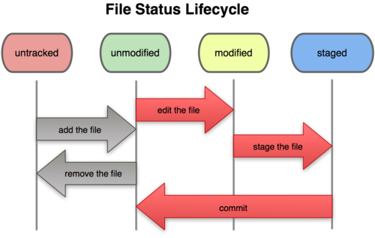
Distributed Version Control with git
gti-scm book License
Andrew Danner, SWICS
22 November 2013

Slide 2
Review of local git
Do this once per network
check git config -l
if no user.name:
git config --global user.name “My Name”
git config --global user.email “me@place.com”
Global options apply to all git repositories on the current system, e.g., CS network, your laptop, your future job
See also https://help.github.com/articles/set-up-git

Slide 3
Starting a new repository
One repo per project.
Only need to do this when starting a new project or preparing to share
git init woot
Local, unshared
git init --bare woot.bare
Create a bare repo (helpful for sharing)
Don’t make edits in this directory
only push to, pull from bare repos
git clone /home/adas/woot.bare localWoot
clone an existing repo for sharing
Usually only clone bare repos
Don’t need to do all three of these every time

Slide 4
Daily workflow
Edit old files
Add new files
git status
git add
“stages” files for commit
git commit, git commit -m
saves changes in history
.gitignore
ignore files that you don’t want to version control
*.o, *.avi, *.bak, *~, .*.swp, build/*

Slide 5
Demo
git config -l
# if needed
git config --global user.name=”Andrew Danner”
git config --global user.email=”adanner@corgination.org”
git init woot
cd woot
vim Readme.txt
git status
git add Readme.txt
git status
git commit -m "initial checkin"
vim prog.py
vim Readme.txt
git status
git add prog.py Readme.txt
git commit -m "I'm programming"
git status
gitg

Slide 6
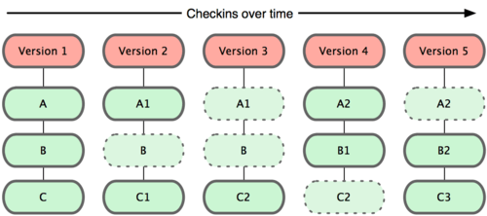
Reviewing changes
git log
gitg, gitx, gitk
graphical browsers of git logs
git status
git commits store “changes” to working tree over time

Slide 7
Some git repo terminology
Working Directory
what your directory currently looks like
pretend git wasn't there
Stage (Index)
Things that are added to be part of next commit
Not committed yet
History (Local repository)
Committed from staging area
Part of git history
Stash
Upstream (Remote repository)
See also Git cheatsheet Link

Slide 8
Git Branching and Merging
Use branches to work on multiple features in parallel
Test out new ideas, fix bugs
You should do most of your development work in a branch
There seems to be a lot of branching FUD surrounding git. These folks probably were burned by some other VCS in the past that had poor branch support
Git has great branch support

Slide 9
Demo - Branching
git status
#create and switch to new branch
git checkout -b devel
git status
vim prog.py
python prog.py
git status
git add prog.py
git commit -m "awesome feature"
#move to existing branch
git checkout master
vim prog.py
git commit -a -m "documented code"
git status
git branch
gitg &
#fixing conflicts
git merge devel
vim prog.py
git status
git add prog.py
git commit
#fast forward merge after conflict
git checkout devel
git merge master
#not all merges result in conflict
HEAD
HEAD
HEAD
master
master
master
master
master
master
master
master
HEAD
devel
HEAD
HEAD
devel
devel
devel
devel
HEAD
devel
devel
HEAD

Slide 10
Git Branching and Merging
git branch newfeature
git checkout newfeature
add some changes
git checkout master
use gitg to view repo history
add changes. branch divergence!!!
git merge <frombranch>
merge conflicts and resolutions
do not blindly add conflicted files back into git
you will most likely break your code
git branch lists, creates, deletes branches

Slide 11
Undoing changes
git mv
git rm removes from git and working tree
git rm --cached only removes from git
git checkout --
git revert, the anti-commit
git rebase
helpful when collaborating
only use on local repos
do not rebase remotes
not really an undo. more of a redo

Slide 12
Remote repositories
Sharing/Collaborating is usually done with a remote repository
git clone
git fetch, git pull
git push
git remote add
git branch -a, -av, -avv
Local stuff still applies
push: share from your local to remote
pull: pull from remote to your local

Slide 13
Demo: Remotes
#make share-able bare git repo
gitcreate.sh myproject
#make a copy to edit
git clone share/myproject/
cd myproject/
ls
touch README
git add README
git commit -m "initial commit"
#create/track master branch
git push -u origin master
vim README
git commit -a -m "added content to README"
#get recent changes
git pull
gitg
#make a copy to edit
git clone share/myproject/
cd myproject/
ls
vim README
git add README
git commit -m "more documentation"
#push to existing remote master
git push
Guests
Host

Slide 14
Remotes
gitcreate.sh is CS only
uses ACLs. OK, not great
CS git server
can work with people off campus
need ssh keys
talk to me or Jeff for repo setup
Github
create free public accounts
not great for class project (public)
private accounts for a fee
After git clone, can ignore most of these details

Slide 15
Other commands
Other tools
git cherry-pick
git stash
git help
Swarthmore git server
github for more public projects
git svn clone

Slide 16
Git resources
Pro Git book
Git @ Swat
Git Terminology See also git help glossary
Git Ready learn git one feature at a time
Git Immersion
Understanding Git
Visual Git Reference
Git Cheatsheet

